Slide 1

EDA on Facebook Users

Slide 2
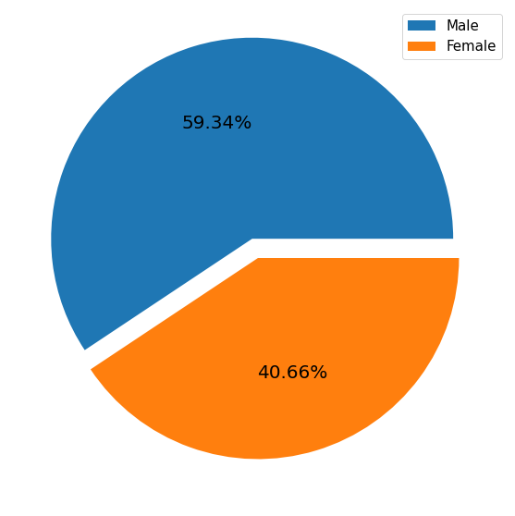
Male vs Female Ratio
Clearly states Male Users are more than Female Users.

Slide 3
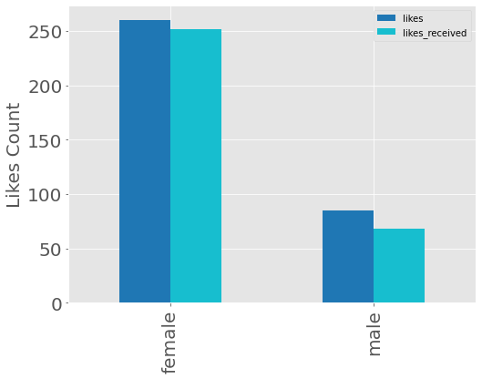
Male vs Female Activity Count
Female Users is more active than Male users in making 'Likes'.
They receive more like as well.

Slide 4
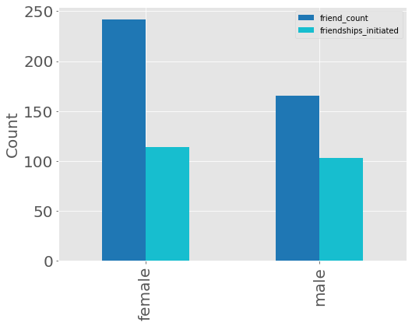
Friends Count vs Friendship Initiated
Clear shows Female per user has more friends than male per user, but friendship initiated by both gender is almost same.

Slide 5
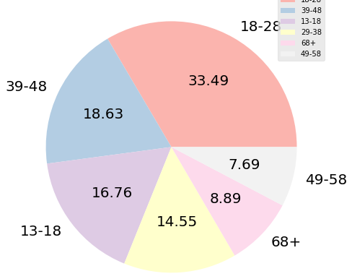
User distribution across Age Groups
50% of users have age between 13-28 years.

Slide 6
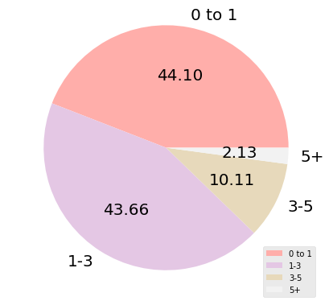
User Distribution across Tenure
88% of the User are under 3 years of tenure.

Slide 7
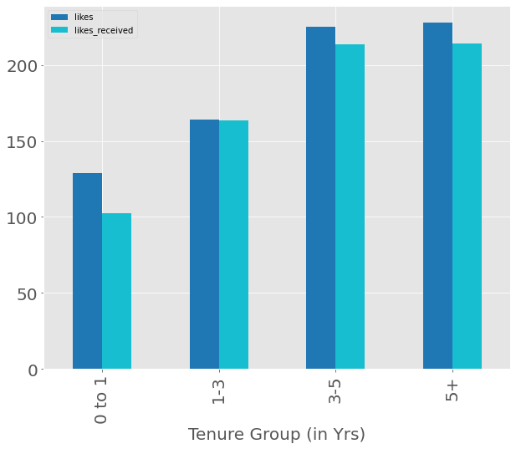
User acress Tenure who Likes or Received Likes
As the tenure increases user activity is also increase.

Slide 8
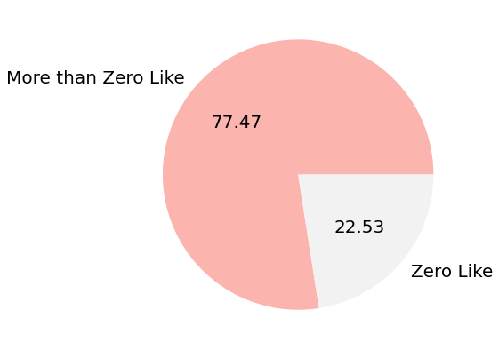
Active users vs Passive users
22.53% user does not do any like.

Slide 9
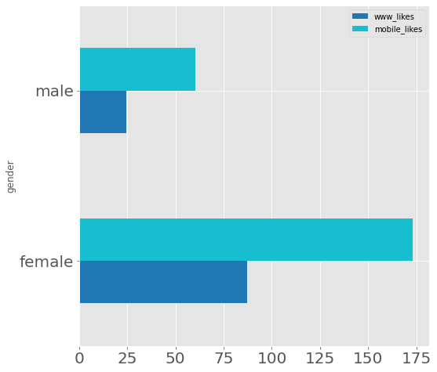
Number of Mobile and Web Users
.

Slide 10
Actionable Insight.
Focus on Female Category as their activities are more than Male Category users.
Males are the more passive users, can do something to engage them.
As 13-28 age group is accounted for 50% users. Keep in mind there interest area to keep them more active.
Mobile users are more than web users. Keep in mind while enhancing/developing anything new.
Males initiate similar number of friendship request as Female but their friend count is less than Female. Can do something to find out the reason.

